Slide 1
ENEL 419
Tutorial Examples: Special Discrete Random Variables

Slide 2
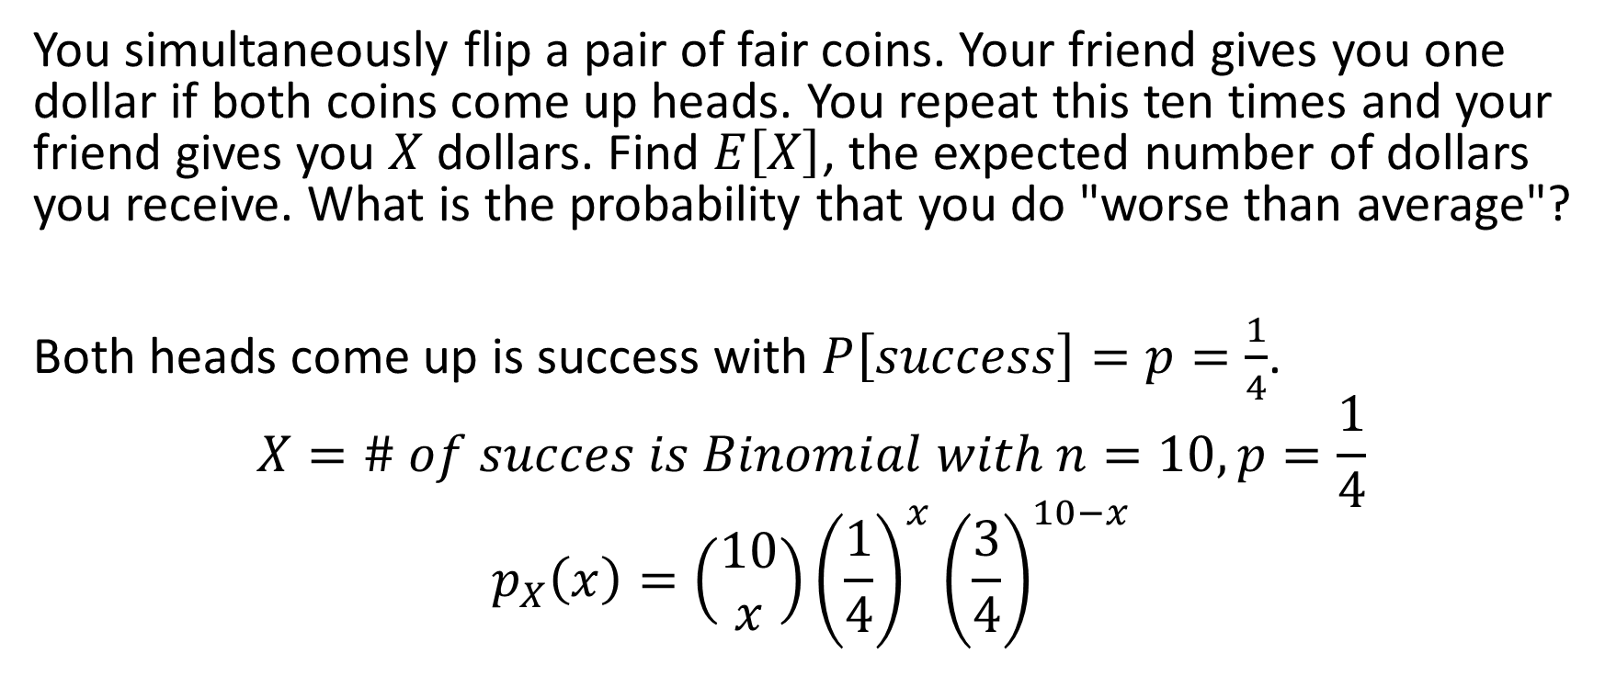
Example 1 Binomial
You simultaneously flip a pair of fair coins. Your friend gives you one dollar if both coins come up heads. You repeat this ten times and your friend gives you $X$ dollars. Find $E\left[X\right]$, the expected number of dollars you receive. What is the probability that you do "worse than average"?
Both heads come up is success with $P\left[success\right]=p=\frac{1}{4}$.
$$X=\# of succes is Binomial with n=10, p=\frac{1}{4}$$
$$p_{X}\left(x\right)=\left(\begin{aligned}10 \\ x\end{aligned}\right){\left(\frac{1}{4}\right)}^{x}{\left(\frac{3}{4}\right)}^{10−x}$$

Slide 3

Example 1 Binomial
Average: $μ_{X}=E[X]=np=2.5$
Probability of $X worse than average is$

Slide 4
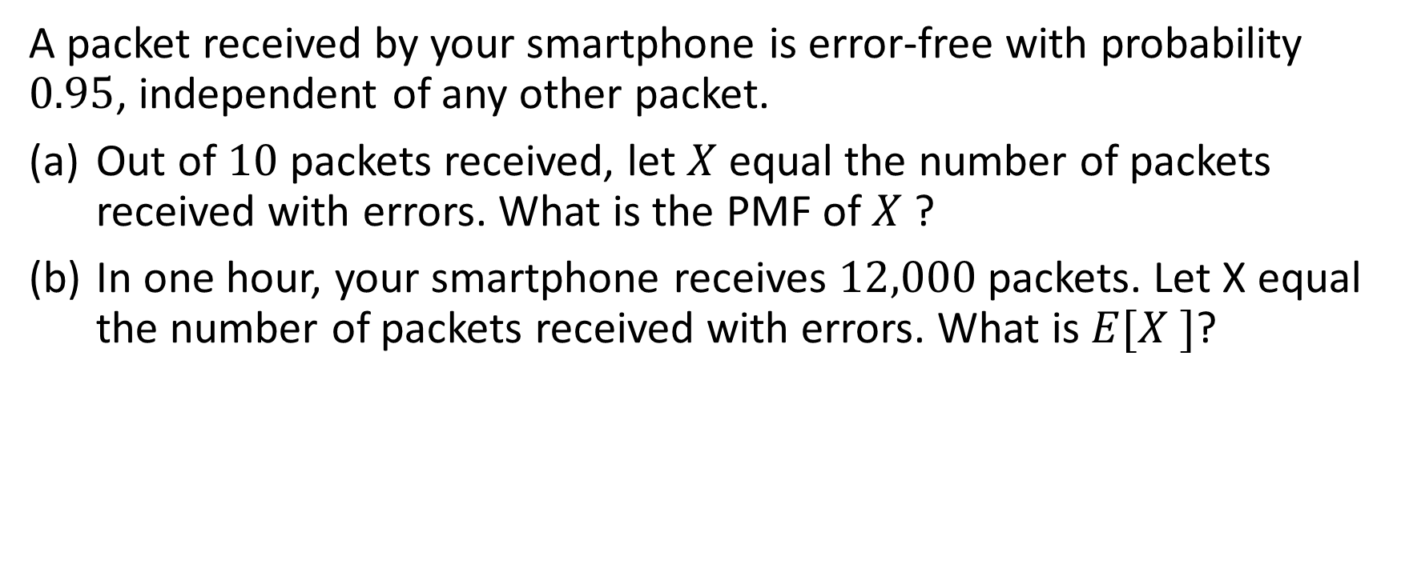
Example 2 Binomial
A packet received by your smartphone is error-free with probability $0.95$, independent of any other packet.
Out of $10$ packets received, let $X$equal the number of packets received with errors. What is the PMF of $X$ ?
In one hour, your smartphone receives $12,000$ packets. Let X equal the number of packets received with errors. What is $E[X ]$?

Slide 5
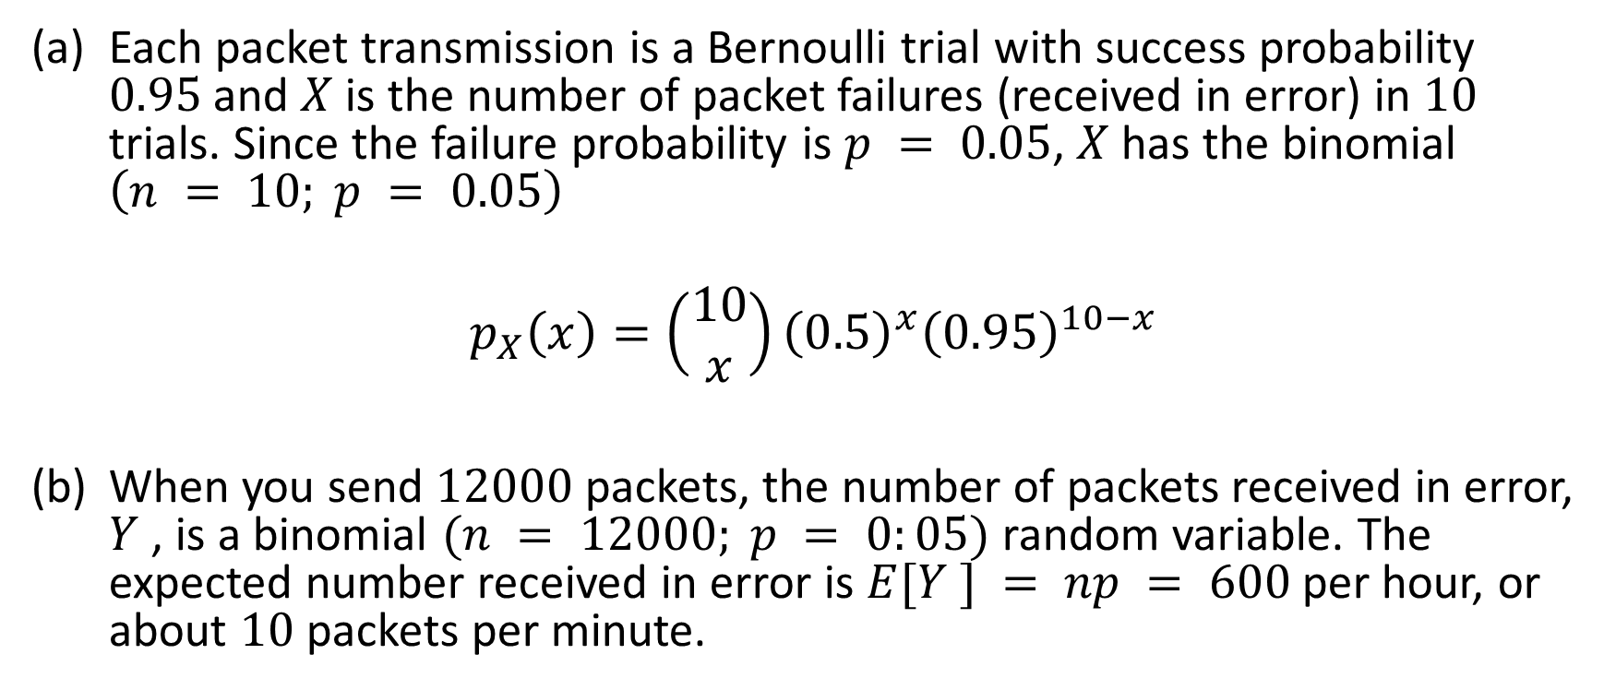
Example 2 Binomial
Each packet transmission is a Bernoulli trial with success probability $0.95$and $X$ is the number of packet failures (received in error) in $10$ trials. Since the failure probability is $p = 0.05$, $X$ has the binomial $\left(n = 10; p = 0.05\right)$
$$p_{X}\left(x\right)=\left(\begin{aligned}10 \\ x\end{aligned}\right){\left(0.5\right)}^{x}{\left(0.95\right)}^{10−x}$$
When you send $12000$ packets, the number of packets received in error, $Y$ , is a binomial $(n = 12000; p = 0:05)$random variable. The expected number received in error is $E[Y ] = np = 600$per hour, or about $10$ packets per minute.

Slide 6

Additional Examples
Find $P[K<E\left[K<E\left[K\right]\right]when$

Slide 7
Geometric Random Variable

Slide 8

Binomial
When $K$ is Binomial $\left(n=6, p=\frac{1}{2}\right)$, it has PMF
$$p_{K}\left(k\right)=\left(\begin{aligned}6 \\ k\end{aligned}\right)p^{k}{\left(1−p\right)}^{6−k}=\left(\begin{aligned}6 \\ k\end{aligned}\right){\left(\frac{1}{2}\right)}^{6} and E\left[K\right]=np=3.$$

Slide 9
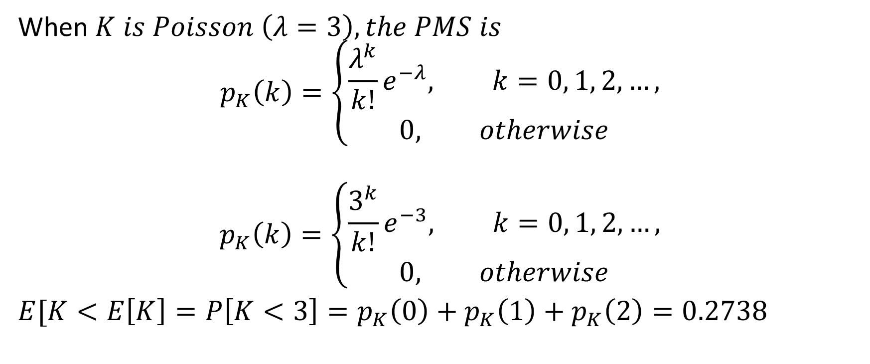
Poisson
When $K is Poisson \left(λ=3\right), the PMS is$
$$p_{K}\left(k\right)=\left\{\begin{aligned}\frac{λ^{k}}{k!}e^{−λ}, k=0, 1, 2, …, \\ &0, otherwise\end{aligned}\right.$$
$$p_{K}\left(k\right)=\left\{\begin{aligned}\frac{3^{k}}{k!}e^{−3}, k=0, 1, 2, …, \\ &0, otherwise\end{aligned}\right.$$
$E[K<E\left[K\right]=P\left[K<3\right]=p_{K}\left(0\right)+p_{K}\left(1\right)+$ $p_{K}\left(2\right)=0.2738$

Slide 10
Discrete Uniform

